Slide 1

Error detection and Correction

Slide 2
When it occurs?
Types of error
Single bit
Burst

Slide 3
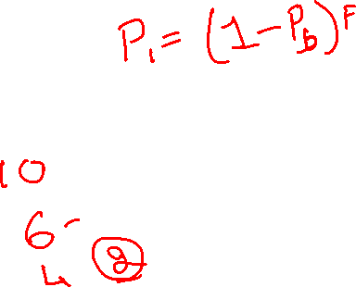
Probability with respect to errors in transmitted frames
Pb: Probability that the bit is received in error(BER)
P1:Probabilitythat the frame arrive with no bit errors.
P2:Probability that an error detection algorithm in use, a frame arrives with one or more detected bit error but no undetected bit error.
P1=(1-Pb)^F
P2=1-P1
Where F is the number of bits per frame

Slide 4
Error detection
Error detection uses the concept of redundancy, which means adding extra bits for detecting errors at the destination.

Slide 5


Slide 6
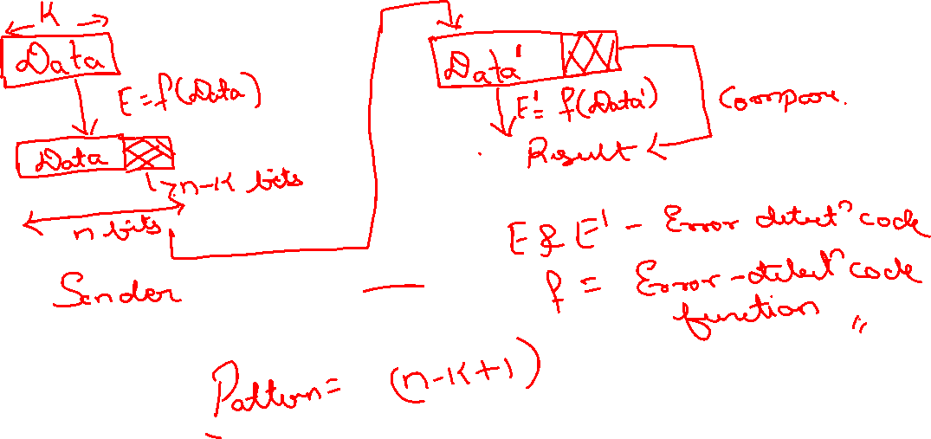

Slide 7
Cyclic Redundancy Check(CRC)
Most powerful and commonly used eorror detection code
Basic approach
Generate Frame check sequence(FCS)
Check if divisible?

Slide 8
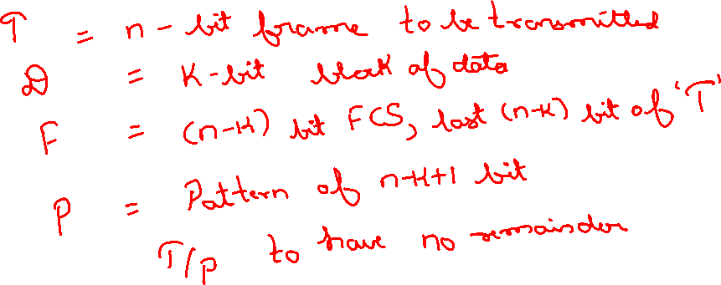
1. Modulo 2 Arithmetic (Exclusive-OR operation)
Proof

Slide 9
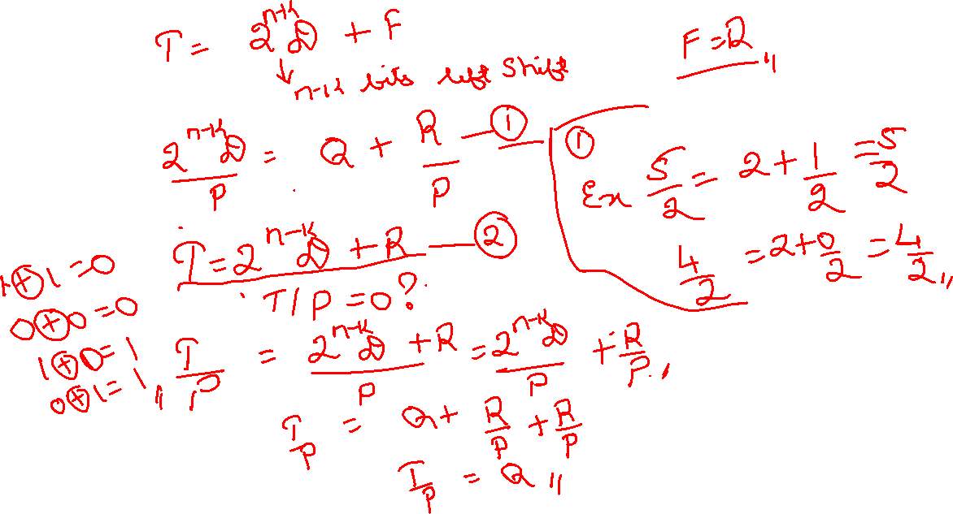
Example 1:

Slide 10
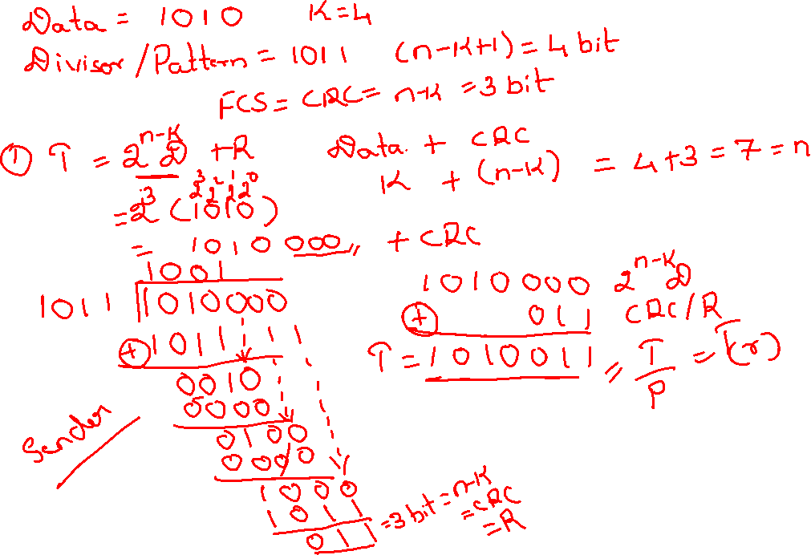

Slide 11
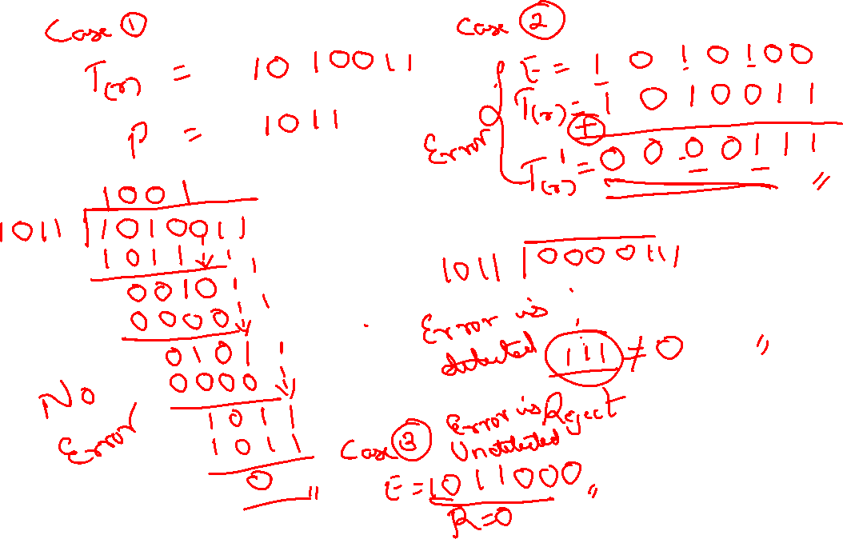

Slide 12
